Slide 1
Creating an LLM WebApp
Mohannad Elhamod – IS883

Slide 2
Cloud Computing

Slide 3



What is Cloud Computing?
The technology that allows us to access computing resources over the internet (as opposed to purchasing our own resources).

Slide 4
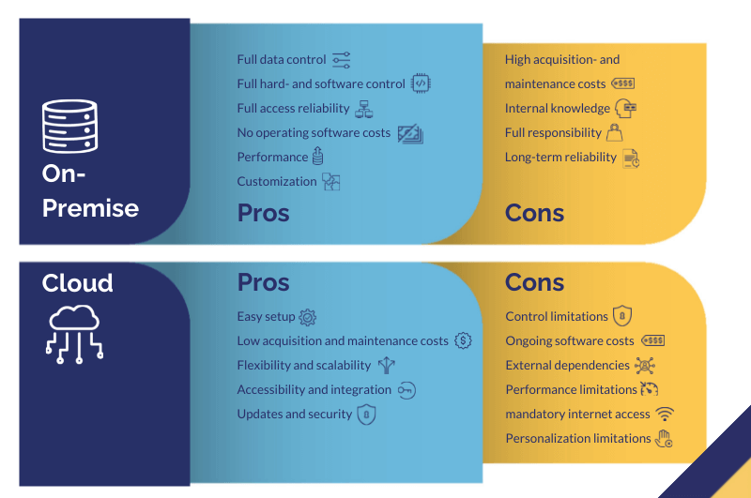
What are the pros and cons?
Renting vs. buying…
wearekemb

Slide 5

Microsoft Azure
Arguably easier to use than the other options.
Easy to integrate with other Microsoft products (and OpenAI!)

Slide 6
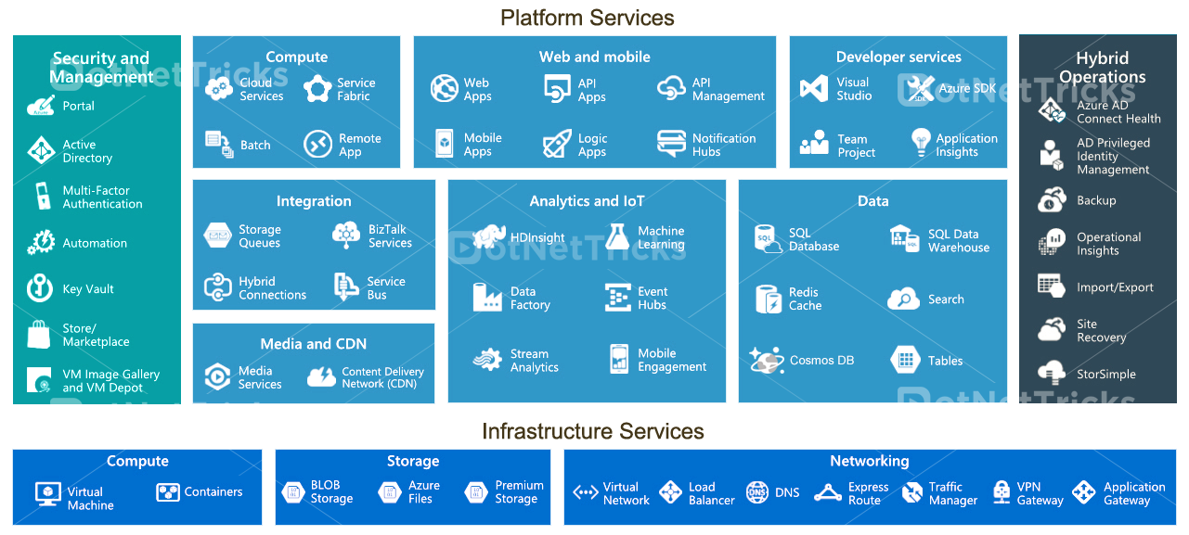
Microsoft Azure
Medium

Slide 7
Code Development Tools

Slide 8

GitHub
Widely used.
Helps with team collaborations.
Tracks code change history.
Can automate tasks such as deployment.
Allows multiple versions of the code (e.g., for different features).

Slide 9
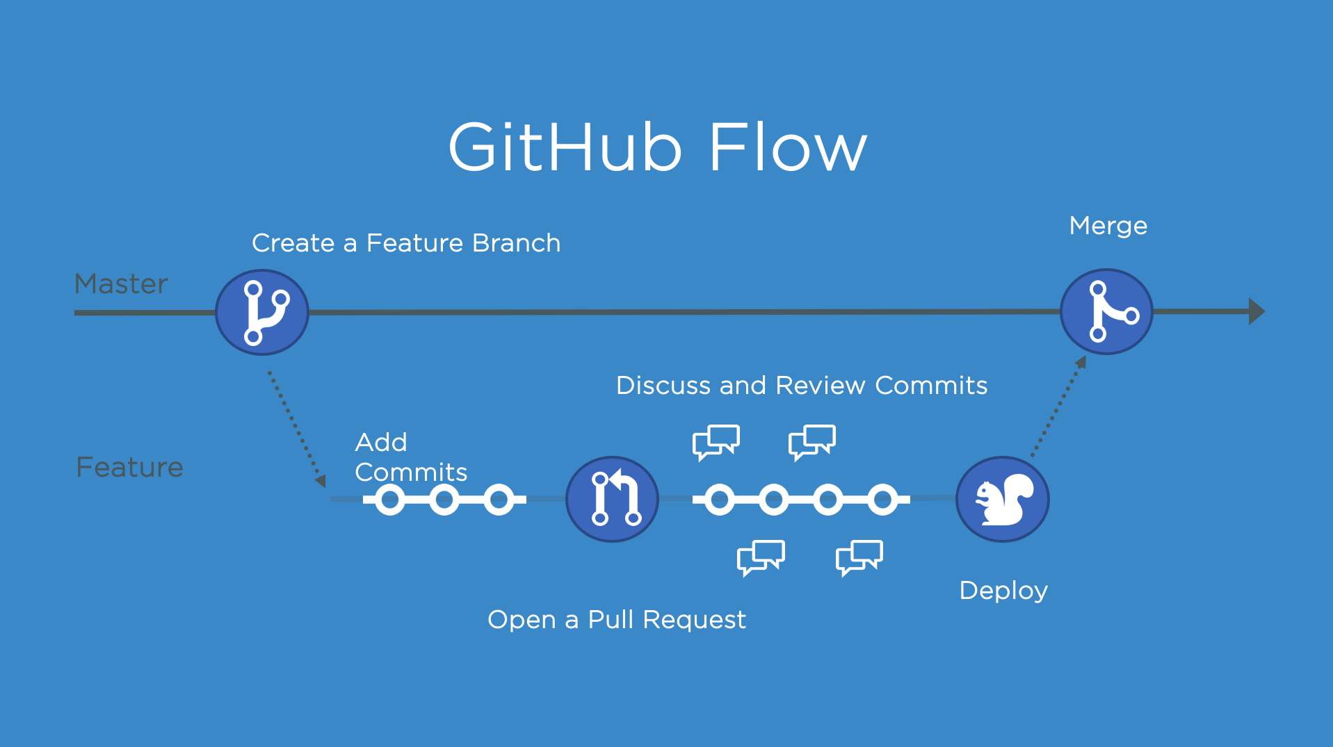
The Git workflow

Slide 10
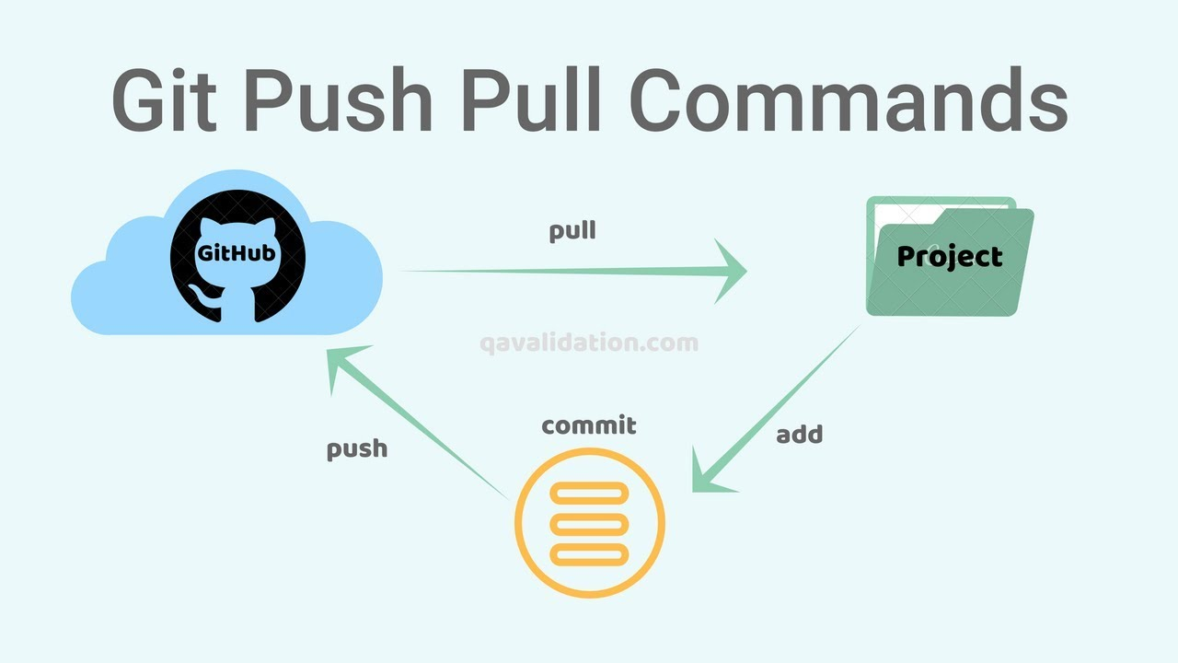
The Git workflow

Slide 11

VS Code
A powerful editor by Microsoft
Lightweight and easy to use.
Can integrate with GitHub.
Helpful features: IntelliSense.

Slide 12
Demo time!

Slide 13
Demo
Azure + OpenAI API demo

Slide 14
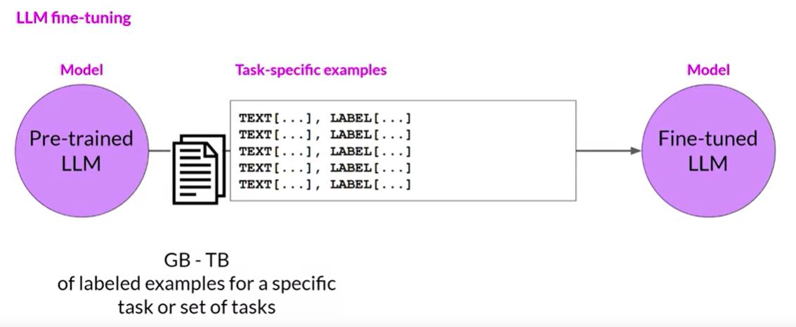
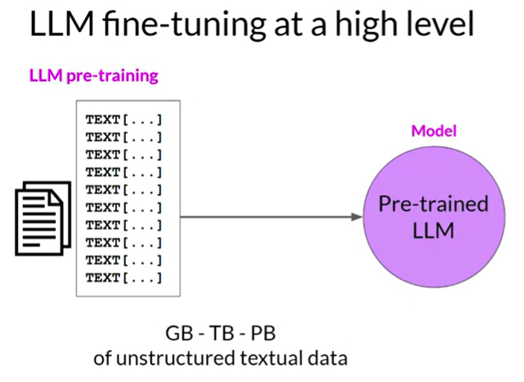
Notes:
https://www.coursera.org/learn/generative-ai-with-llms/lecture/exyNC/instruction-fine-tuning

Slide 15
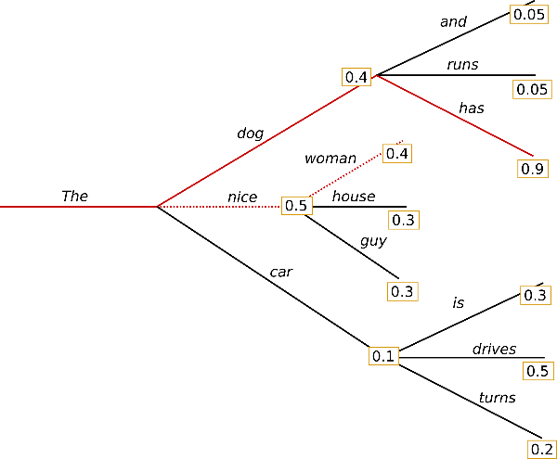
Notes:
https://colab.research.google.com/github/huggingface/blog/blob/main/notebooks/02_how_to_generate.ipynb#scrollTo=5ClO3VphqGp6 top k top p beam…etc

